Slide 1
Carbon Cycle Review
What do you remember about the Carbon Cycle?
Notes:
Draw student recollections of the “short” cycle on the board.

Slide 2
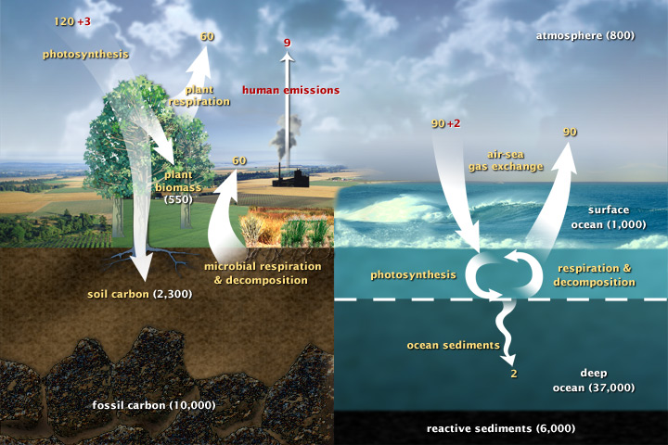
https://www.earthobservatory.nasa.gov/ContentFeature/CarbonCycle/images/carbon_cycle.jpg
Notes:
“This diagram of the fast carbon cycle shows the movement of carbon between land, atmosphere, and oceans. Yellow numbers are natural fluxes, and red are human contributions in gigatons of carbon per year. White numbers indicate stored carbon. (Diagram adapted from U.S. DOE, Biological and Environmental Research Information System.)”
https://www.earthobservatory.nasa.gov/ContentFeature/CarbonCycle/images/carbon_cycle.jpg
“Over the long term, the carbon cycle seems to maintain a balance that prevents all of Earth’s carbon from entering the atmosphere (as is the case on Venus) or from being stored entirely in rocks. This balance helps keep Earth’s temperature relatively stable, like a thermostat.
This thermostat works over a few hundred thousand years, as part of the slow carbon cycle. This means that for shorter time periods—tens to a hundred thousand years—the temperature of Earth can vary. And, in fact, Earth swings between ice ages and warmer interglacial periods on these time scales. Parts of the carbon cycle may even amplify these short-term temperature changes.“

Slide 3
Unit 17 – Fossil Fuels

Slide 4
KEY TERMS
Crude oil: unrefined petroleum – straight from the ground
Fossil fuel: a natural fuel such as coal or gas, formed from the remains of ancient organisms.
Off-shore drilling: a process that is used to extract oil from beneath the ocean floor.
Executive order: a rule or order issued by the president to an executive branch of the government and having the force of law.
Keystone Pipeline: an oil pipeline system linked between Canada and the United States.
Energy security: the affordable and accessible source(s) of energy that a country can provide for itself without the need or help from other countries.
EPA: Environmental Protection Agency - an agency of the Federal government of the United States which was created for the purpose of protecting human health and the environment

Slide 5
Unit 17 Ch 1 – Fossil Fuels Intro

Slide 6
What are fossil fuels? (2:42 mins)
Write the questions and then answer during video
1. What are the 3 main types of fossil fuels?
2. What are some ways we use fossil fuels?
3. What are some issues with fossil fuels?
https://www.youtube.com/watch?v=zaXBVYr9Ij0

Slide 7
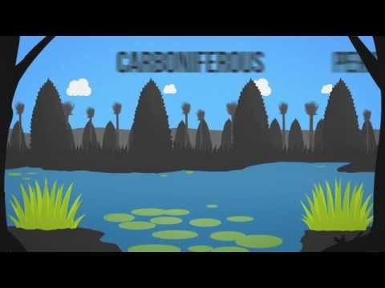
Fossil Fuels 101 Video
https://www.youtube.com/watch?v=zaXBVYr9Ij0
Notes:
https://www.youtube.com/watch?v=zaXBVYr9Ij0

Slide 8
What are fossil fuels? (2:42 mins)
Write the questions and then answer during video
https://www.youtube.com/watch?v=zaXBVYr9Ij0
1. What are the 3 main types of fossil fuels?
2. What are some ways we use fossil fuels?
3. What are some issues with fossil fuels?
Coal, Natural Gas, Oil
Energy source- electricity, transport fuels, plastics, cosmetics, medicines
Can be expensive, non-renewable (cannot be replenished in human lifetime), additional safety and environmental concerns, emit CO2 (causing greenhouse effect)

Slide 9
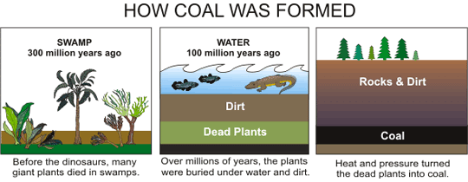
It CANNOT be replenished within a human lifetime, so fossil fuels are considered NON-RENEWABLE RESOURCES

Slide 10
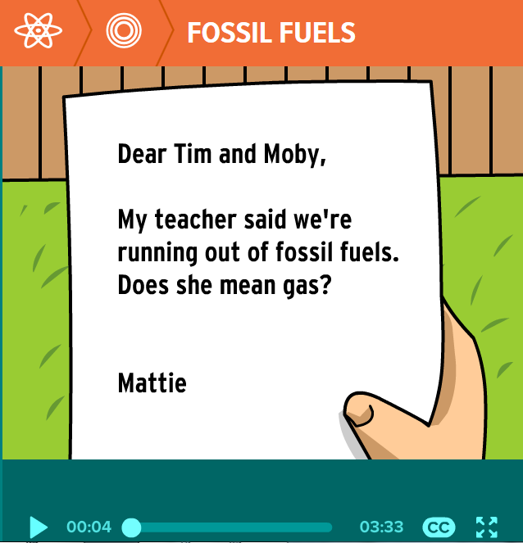
Brain Pop Video – What are Fossil Fuels? How are they Created?
Login Info:
  Username: 255q
  Password: brainpop
  Link: click here to access video
  Note: if the brainpop username and password doesn’t work, you may need to google search free login codes.

Slide 11
300 years of fossil fuels in 300 seconds
click here to watch the video

Slide 12
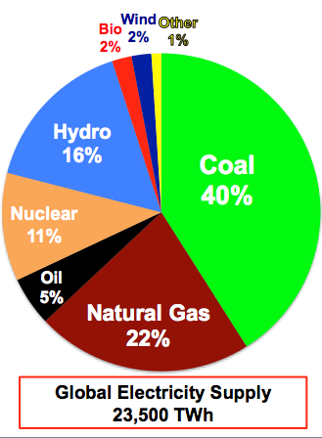
What is running the world?
What are examples of clean power?
Hydroelectric, Solar, Geothermal, Wind
Why can’t we just completely switch to clean energy in the next several years?
    The global economy would crash – too many countries rely on the MONEY that fossil fuels supply.
    THOUSANDS of people would lose their jobs.

